Slide 1
Programming the Blockchain with .NET Core
Henry He

Slide 2

Bio
Henry He
MCSD with years software design and development experience
Blockchain Club Organizer at Medidata
Blockchain Columnist at C# Corner
Winner of Blockchain Hackathon at IDT

Slide 3
Agenda
What is Blockchain?
History of Blockchain
Blockchain Concepts
Build a Blockchain
Basic Blockchain
Proof of Work
Transaction and Reward
P2P Network
A Real World Blockchain Application
Q & A

Slide 4
What is Blockchain?

Slide 5
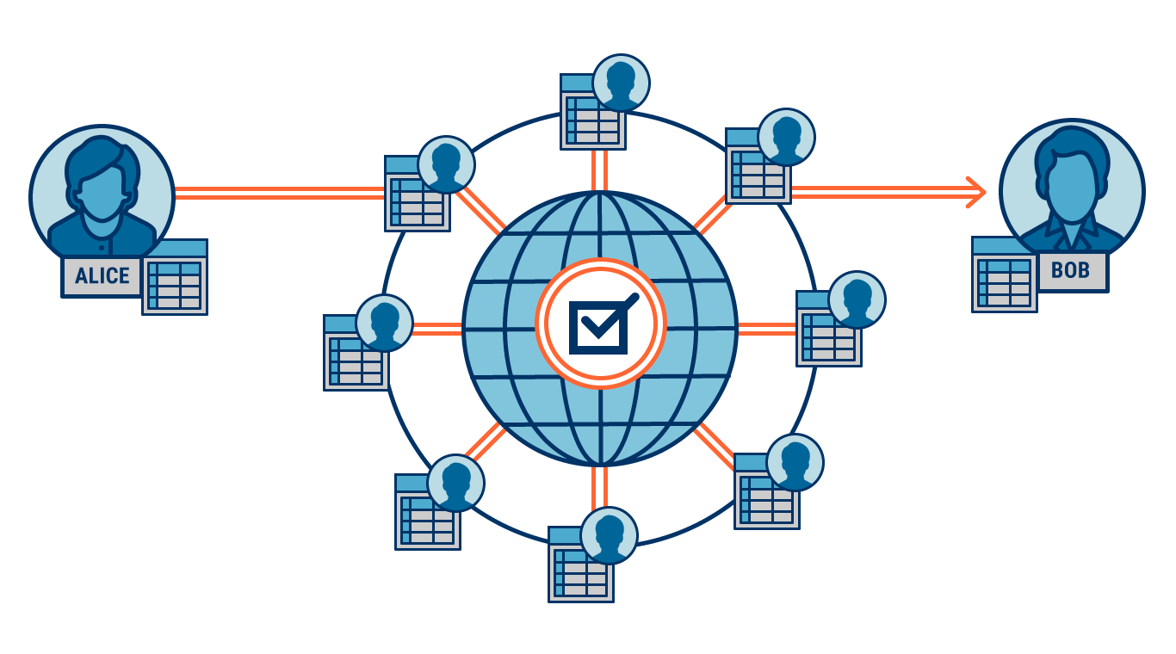
What is Blockchain?
Database
Secure Storage
Decentralized System
Data Exchange Protocol / Paradigm / API

Slide 6
History of Blockchain?

Slide 7
History of Blockchain
1998: B-money by Wei Dai
- Proof-Of-Work
2008: Bitcoin: A peer-to-peer Electronic Cash System by Satoshi Nakamoto
- Implementation
2013: Ethereum by Vitalik Buterin
- Smart Contract
2014: Blockchain 2.0
2016: Blockchain is widely adopted in all industries

Slide 8
History of Blockchain - Adoption
2016: JPMorgan launched Quorum blackchain
2016: Walmart partnered with IBM used Blockchain to detect and remove recalled foods
2017 Nasdaq and Citi launched Blockchain-based payment service
2017 Pfizer, Genentech, and group of companies announce MediLeger project
2018: Microsoft announced a Blockchain Based Payment system for XBOX
2018: Fedex invested in Blockchain technology to improve its freight business

Slide 9
Blockchain Concepts

Slide 10
Blockchain Concepts
Bitcoin
Ethereum
P2P
Node
Block
Mining
Consensus
PoW
PoS
Smart Contract
Notes:
Bitcoin: The first blockchain network
Ethereum: The first smart contract blockchain network
P2P: Peer-to-peer
Node: a computer on a Blockchain network
Block: a data structure contains transactions / data
Mining: A process of adding a new block
Consensus: Agreements followed by all nodes
PoW: Proof of Work
PoS: Proof of Stack
Smart Contract: A program that runs in a blockchain

Slide 11
Build a Blockchain with .NET Core

Slide 12
Build a Blockchain with .NET Core
Visual Studio 2017
.NET Core 2.1

Slide 13
Basic Blockchain

Slide 14
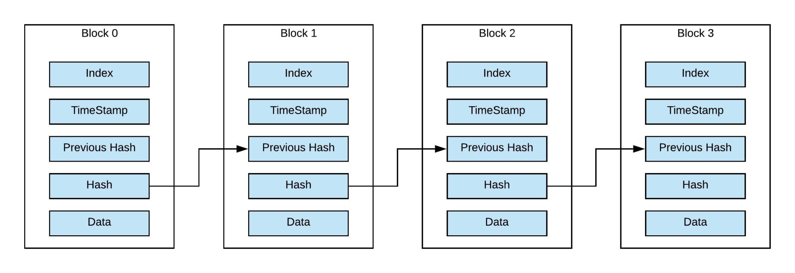
Basic Blockchain

Slide 15
Proof of Work

Slide 16
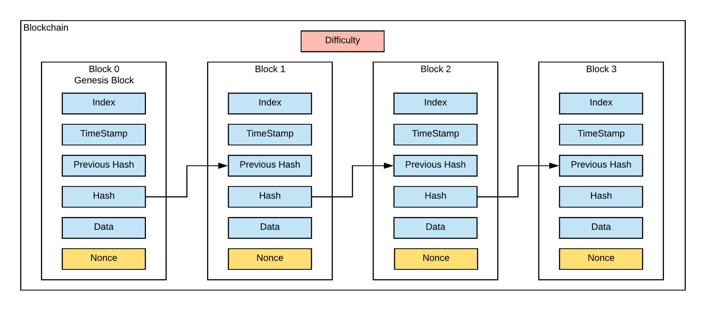
Proof of Work

Slide 17
Transactions
and
Reward

Slide 18
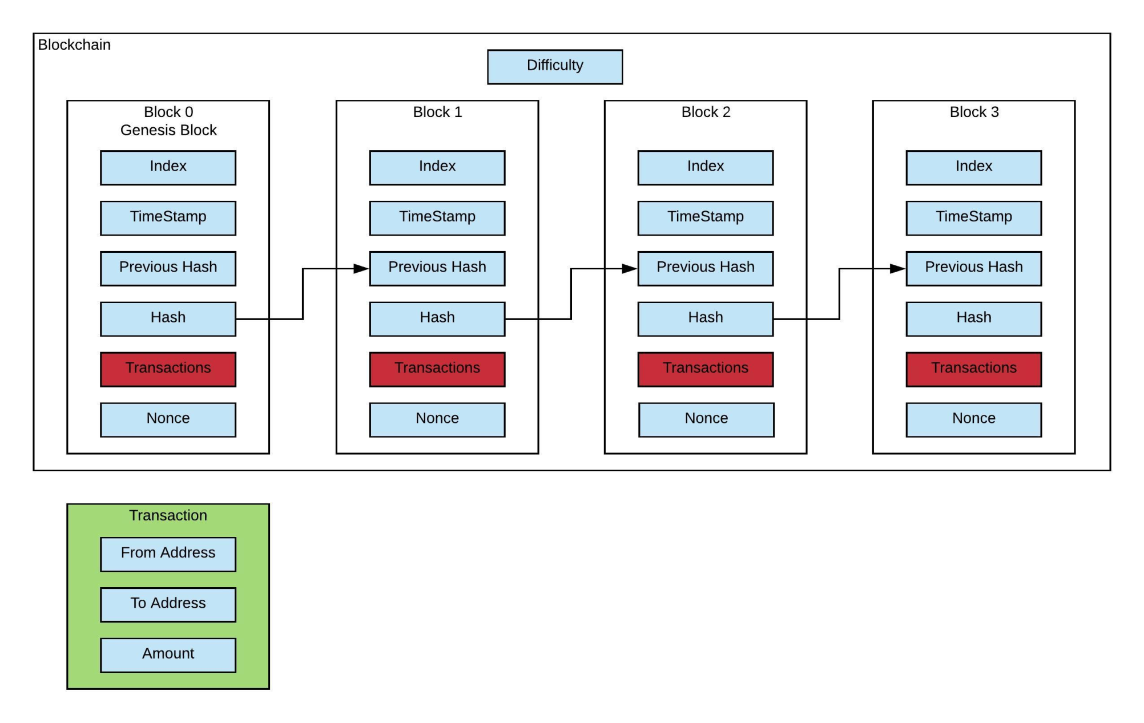
Transaction and Reward

Slide 19
P2P Network

Slide 20
P2P Network

Slide 21
A Real World Example
Blockchain Based Patient Management System

Slide 22
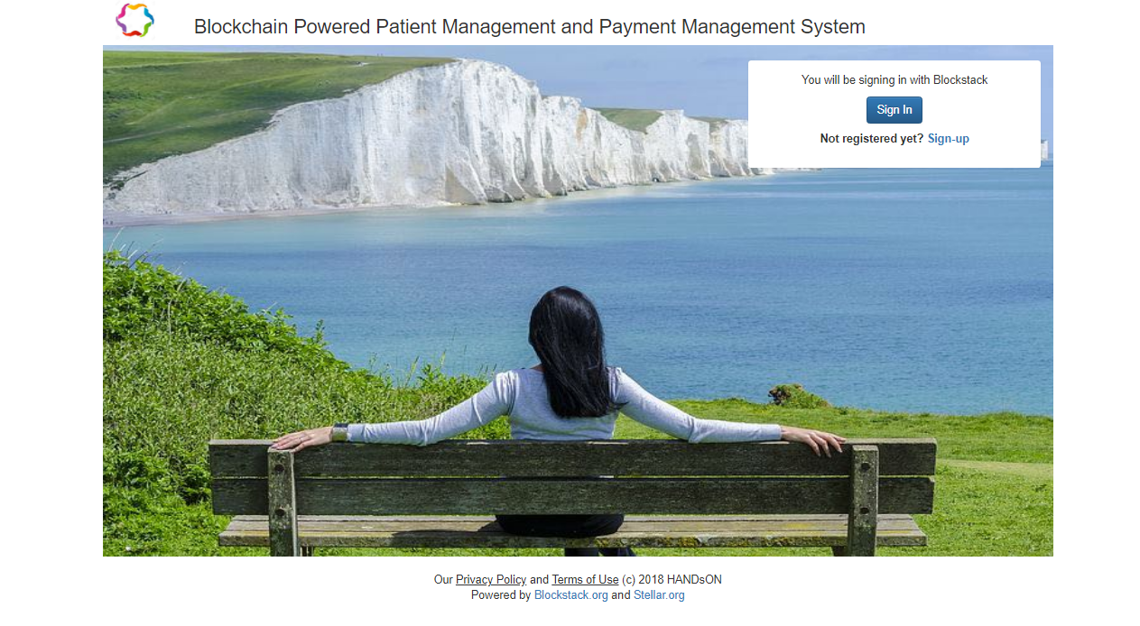
HANDsON

Slide 23
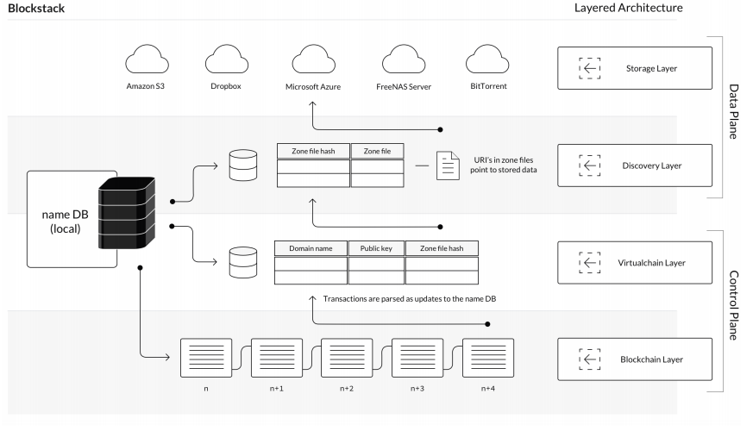
Blockstack

Slide 24
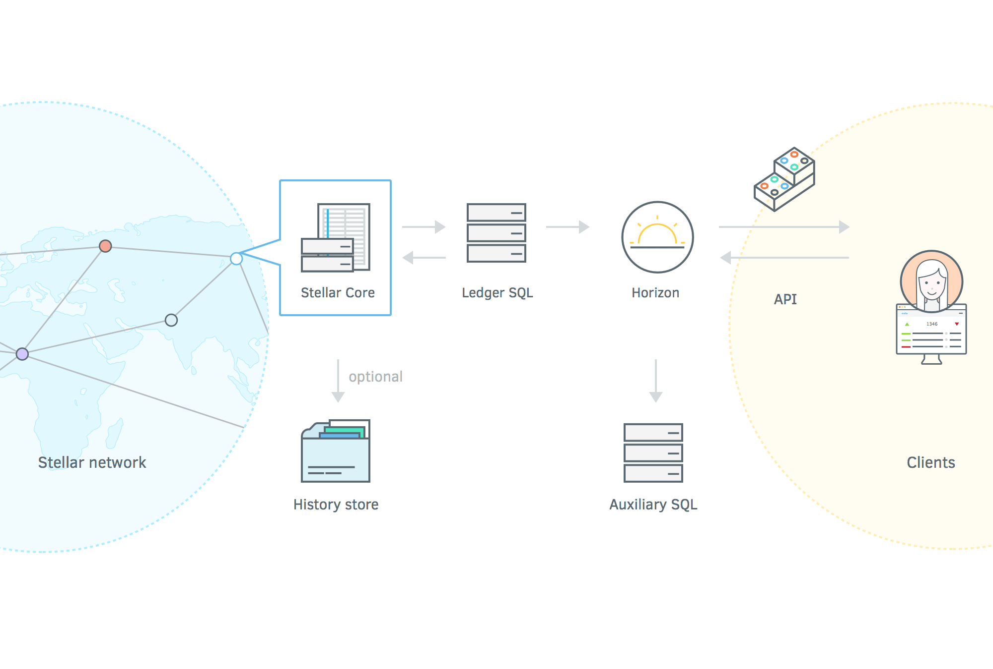
Stellar

Slide 25
Microsoft believes blockchain is a transformational technology with the ability to significantly reduce the friction of doing business.
- Mark Russinovich (CTO, Microsoft Azure)

Slide 26
Q & A
Contact
Email: henryhe9999@gmail.com
Blog: http://henrycomputerworld.blogspot.com/
GitHub: https://github.com/henryhe9999
Twitter: https://twitter.com/henryhe9999
C# Corner: https://www.c-sharpcorner.com/members/henry-he3

